Slide 1
Data Analytics For Understanding Career Aspirations Of GENZ
KULTUREHIRE Virtual Internship
Presented by: Shruti Tatkare

Slide 2
Table of contents
01
02
03
04
05
06
Project Overview
09
Strategic Recommendations
Methodology
10
Applying Gen-Z Workforce Insights to Infosys
Task 1: Problem Statement Documentation
Task 2: Data Collection
11
Ratings for Infosys
Task 3: Data Cleaning & Standardization
12
Insights
Task 4: Exploratory Data Analysis (Excel)
13
Recommendations for Infosys
07
Task 5: Data Analysis using SQL
14
Appendix
08
Task 6: Data Visualization using Power BI/Excel
15
Conclusion

Slide 3
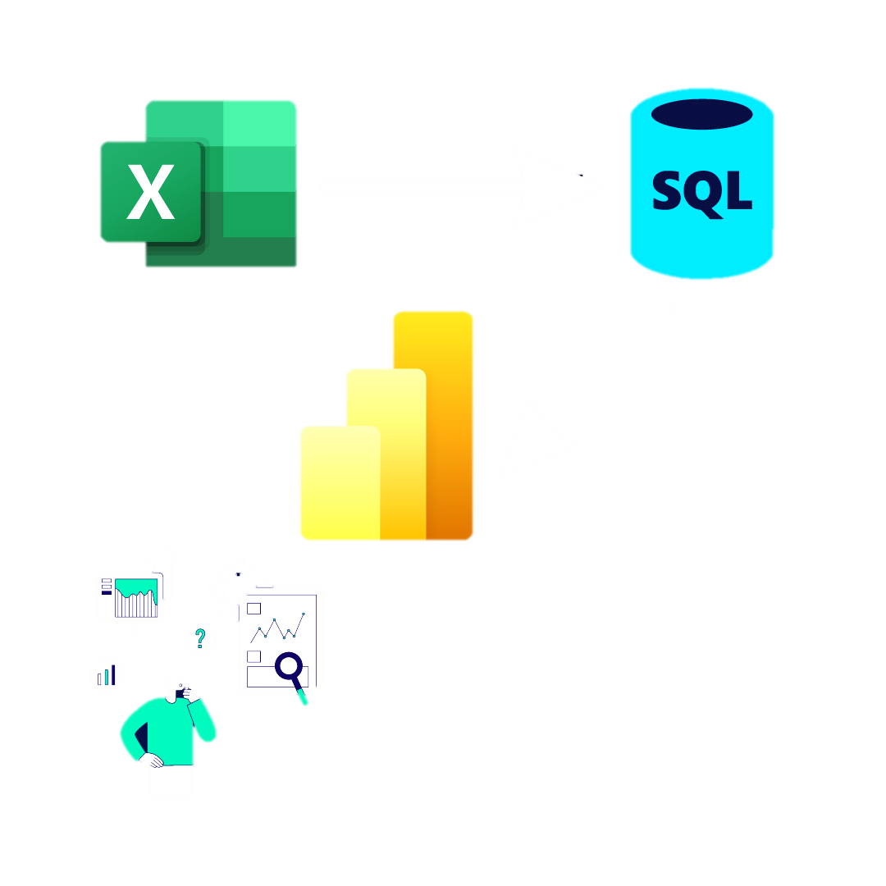
Project Overview
Objective: To explore and analyze the career-related aspirations, expectations, and influencing factors for Generation Z, leveraging structured data collection and analysis methods.
Scope: Career preferences, leadership expectations, work-life balance, values, and compensation insights
Tools Used: Excel, MySQL, Power BI
Data Source: Survey of Gen Z respondents

Slide 4
Methodology
Problem Statement Documentation
Data Collection
Data Cleaning and Standardi-zation
Explorato-ry Data Analysis (EDA) in Excel
Data Analysis in SQL
Data Visualization in Power BI
Project Presentat-ion
Used 5W1H framework
Performed stakeholder analysis
Used Structured Google Form
Targeted GenZ
Normalised data
Handled Missing Values
Used pivot tables and charts to observe trends and distributions.
Performed in-depth analysis through queries involving aggregation, filtering, and joins to extract insights.
Created interactive and focused dashboards
Summarized findings into a stakeholder-friendly presentation

Slide 5





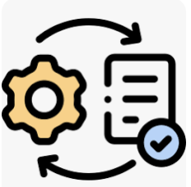
Task 1: Problem Statement Documentation
Used 5W1H Framework to identify the disconnect between Gen Z and employers
What
Why
Who
Where
When
How
Gen Z feels misunderstood
Employers struggle to engage
Expectation mismatch
Outdated hiring
Poor communication
Gen Z job seekers
Recruiters
Employers
Colleges
Recruitment
Onboarding
Workplace
Early careers
Post-pandemic
Hiring spikes
Surveys
Interviews
Gap analysis
Flexible solutions

Slide 6
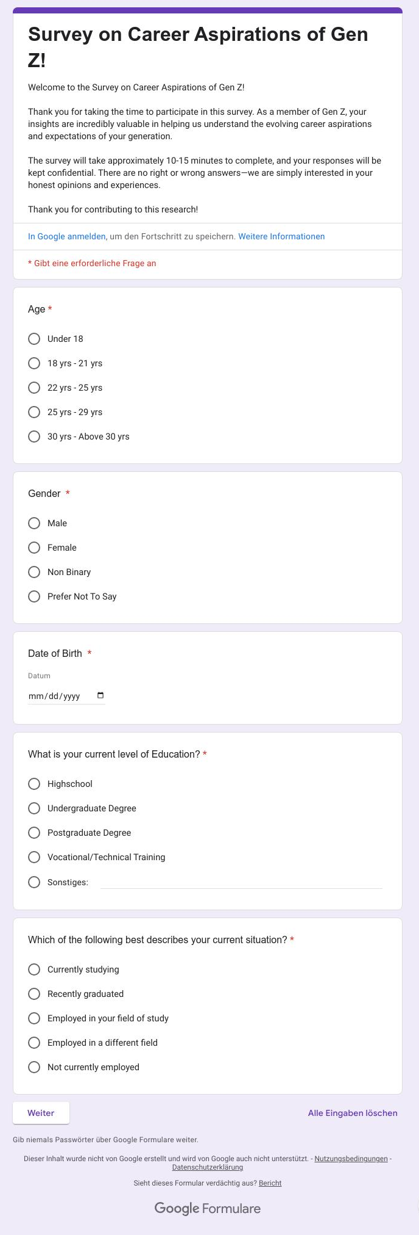
Task 2: Data Collection
Tool: Google Form
Audience: College students, young professionals
Questions gathered: Aspirations, values, salary expectations, work preferences
Link: Survey on Career Aspirations of Gen Z!

Slide 7
Task 3: Data Cleaning & Standardization
Tool: MySQL Workbench, Excel Power Query
Actions: Removed nulls, Ensured consistent data types, Standardized categorical responses
Task 4: Exploratory Data Analysis (Excel)
Created charts and pivot tables to perform high level analysis
Supported decision to create segmented dashboards

Slide 8
Task 5: Data Analysis using SQL
🔑 Key Insights from SQL Analysis
Top Career Aspirations:
Gen Z prefers roles like Strategist, Data Analyst, and Business Operations.
Low interest in traditional fields like Government, Manufacturing, and BPO.
Career Influencers:
Parents are the most significant influence, followed by visionaries and social media.
Friends and movies have minimal impact on career choices.
Work Environment Preferences:
Hybrid work is the most preferred setup.
Fully remote roles are least desirable, despite the tech-savvy demographic.
Salary Expectations:
Early career expectation: ₹31k–₹40k per month.
3-year goal: Over ₹50k for the majority.
5-year vision: ₹1.5L+ for a substantial portion of respondents.
Work-Life Balance:
Most respondents want structured breaks every 2–3 months.
Suggests a high emphasis on mental wellness and rejuvenation.
Ethics & Values:
81% are unwilling to work under abusive managers.
Majority will not work for companies with no social mission or conflicting values.
Alignment with personal purpose is a core factor in job selection.

Slide 9
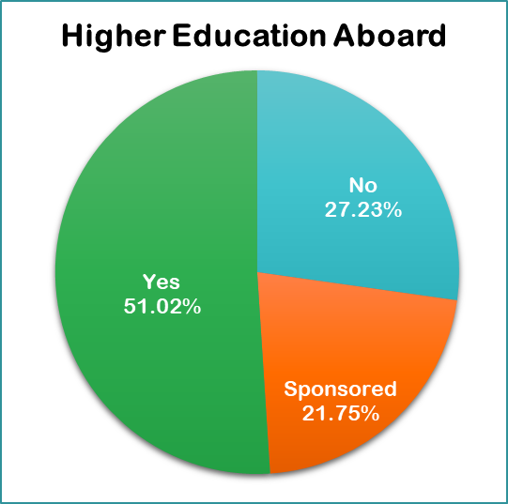
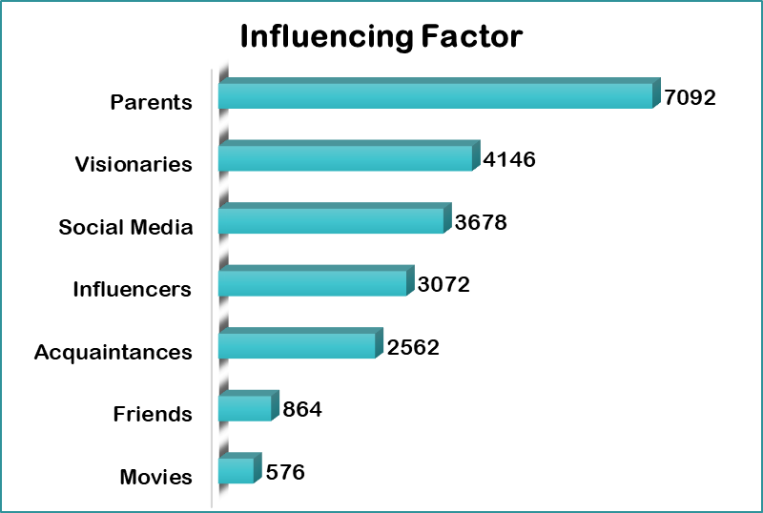
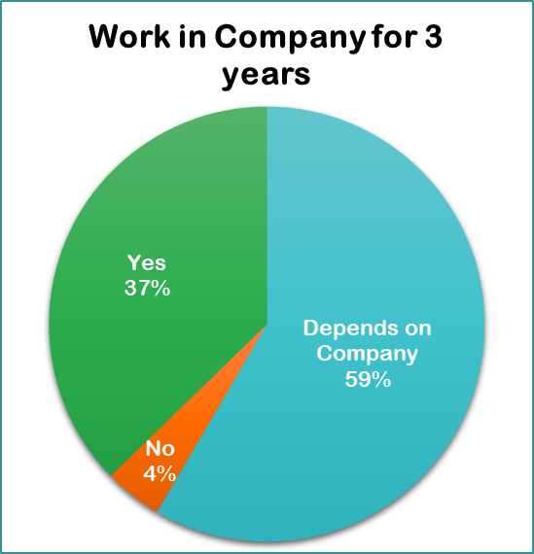
Task 6: Data Visualization using Power BI/Excel
Learning & Development Aspirations

Slide 10

📘 I. Insights for Learning & Development Aspirations
1. Global Academic Ambitions & Corporate Sponsorship Demand
51.02% of Gen-Z respondents aspire for higher education abroad, with 21.65% expecting sponsorship.
Indicates a trend toward continuous, international learning as a career accelerator.
Suggests a shift in expectations — employers are seen as partners in education, not just work.
2. Parental Influence is Paramount
Parents are the top influencing factor, well ahead of visionaries, influencers, and peers.
Reveals a culturally rooted decision-making ecosystem where family plays a gatekeeping role.
Highlights that personal decisions like career path, location, and employer choice are often collectively influenced.
3. Career Commitment is Conditional
Only 37% express willingness to work in a company for 3 years; 59% say it depends.
Indicates a fluid mindset toward long-term employment, driven by growth, learning, and workplace experience.
Loyalty is no longer implicit — it's earned through value alignment and opportunities.

Slide 11
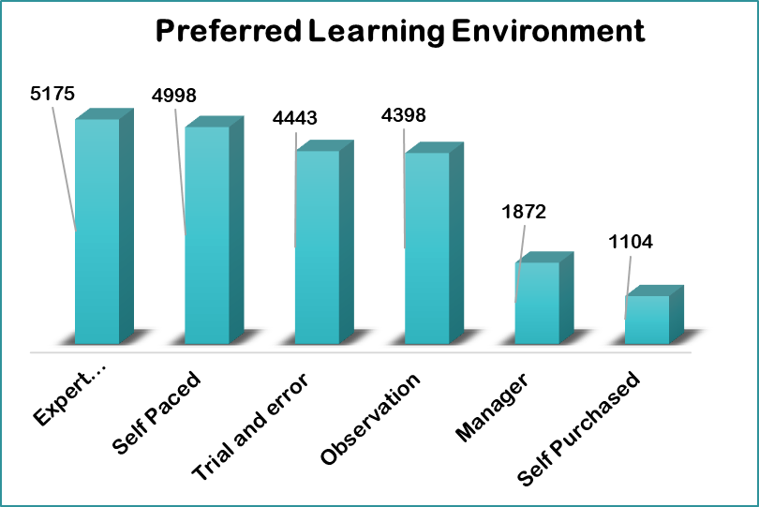
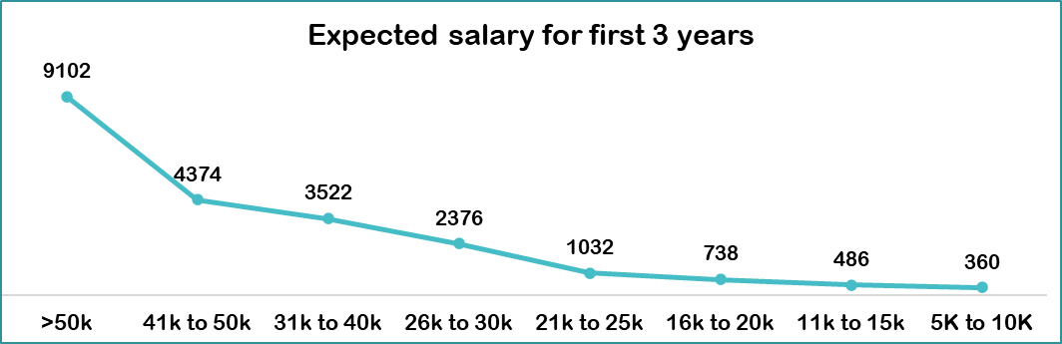
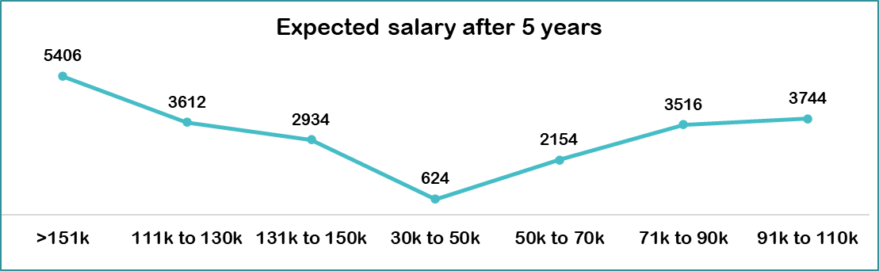

Slide 12
📘 I. Insights for Learning & Development Aspirations
4. Expected Salary Trends Reveal Value-Awareness
Majority expect ₹31k–40k monthly starting salary; rises to ₹50k–100k within 3 years and ₹71k–150k after 5 years.
Reflects high financial ambition and awareness of market benchmarks.
Suggests early-career compensation is a key decision filter, and salary growth expectations are steep.
5. Learning Preferences Emphasize Autonomy & Collaboration
Top learning formats: Expert-Led, Self paced, and Trial & error.
Suggests Gen-Z seeks dynamic, participatory, and expert-driven learning — not passive formats.
Indicates an evolution away from rigid classroom-style L&D toward experiential learning ecosystems.

Slide 13
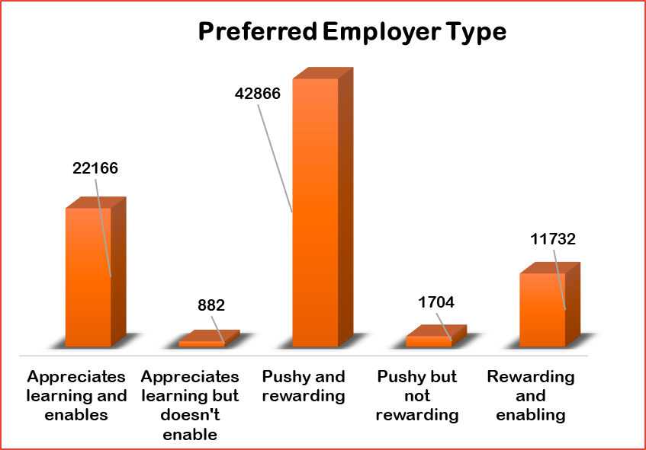
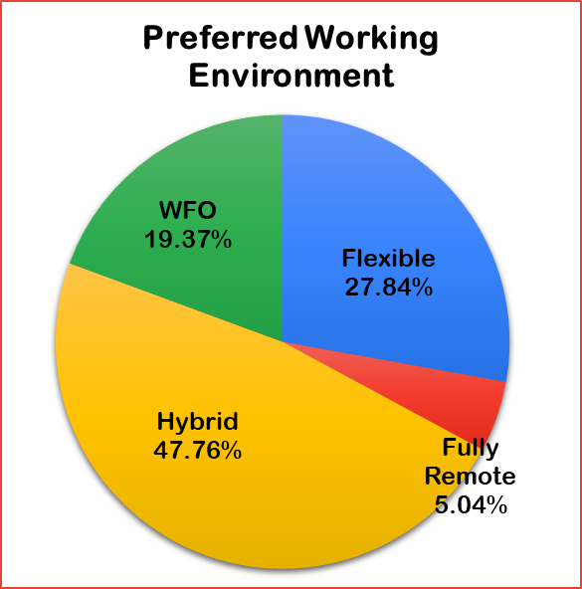
Work Environment & Managerial Expectations

Slide 14

📙 II. Insights for Work Environment & Managerial Expectations
1. Pushy-but-Rewarding Culture is Favored
Over 54% prefer employers who challenge and reward rather than those who merely enable.
Indicates a performance-oriented culture preference, provided rewards are tangible and visible.
Reflects a desire to be part of high-expectation environments with clear pathways to success.
2. Hybrid is the New Norm
47.76% prefer hybrid work, followed by 27.84% opting for flexible setups.
Shows workplace flexibility is non-negotiable for Gen-Z, while pure WFO or remote models are declining.
Reflects demand for autonomy, mobility, and collaboration, all in balance.

Slide 15
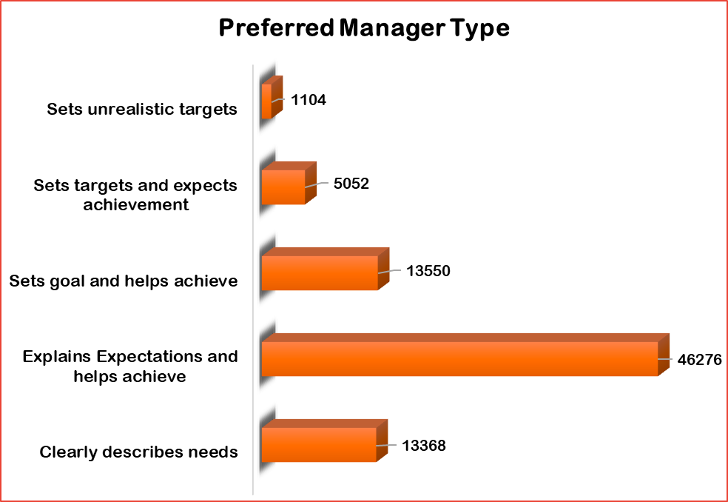
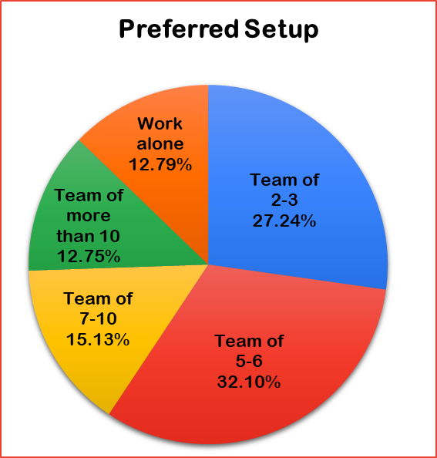
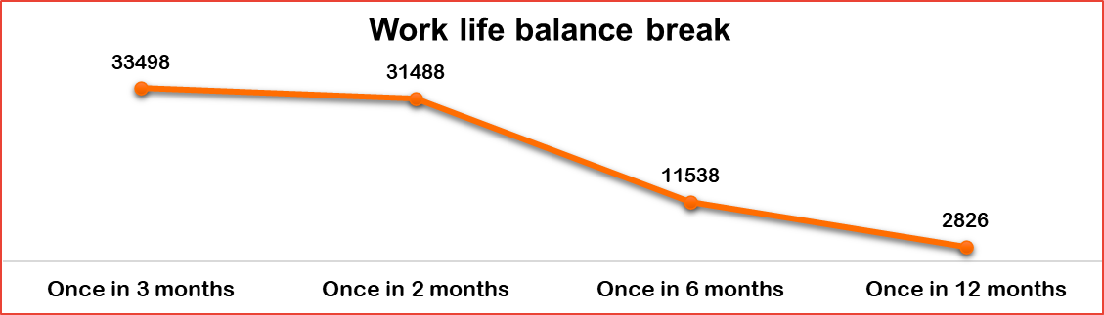

Slide 16
📙 II. Insights for Work Environment & Managerial Expectations
3. Work-Life Balance is Defined by Regular Recharge Cycles
Majority expect breaks every 2–3 months.
Gen-Z redefines work-life balance as planned decompression, not just leave policies.
Indicates burnout prevention is preemptive, not reactive.
4. Preferred Manager Archetype: Supportive with Expectations
Top choice: "Sets clear expectations and helps achieve" (46,278 responses).
Coaching-style leadership is preferred over performance-pressure or laissez-faire approaches.
Suggests Gen-Z seeks clarity, support, and constructive feedback from management.
5. Team Collaboration Over Isolation
Highest preference is for teams of 2–3 or 5–6 people.
Reveals a preference for small, agile, collaborative teams.
Suggests that workplace design, project structures, and tools should enable cohesion and dialogue.

Slide 17
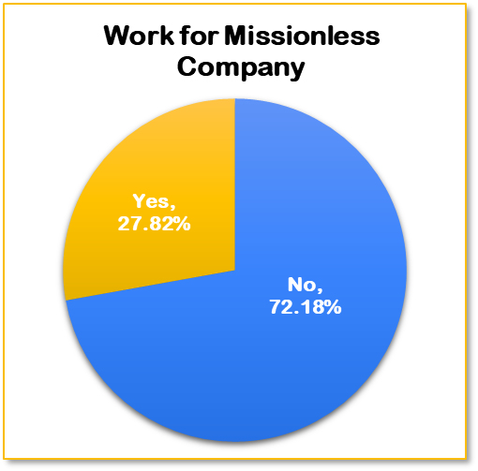
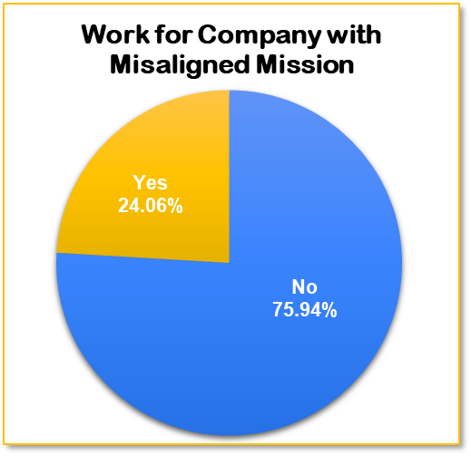
Mission Alignment & Social Impact Aspirations

Slide 18

🌍 III. Mission Alignment & Social Impact Aspirations
1. Purpose-Driven Workplaces Are a Priority
72.18% would not work for a company without a clear mission.
Suggests corporate purpose and clarity are core to employer attractiveness.
Highlights Gen-Z’s deep alignment with societal contribution and values.
2. High Rejection Rate of Misaligned Missions
79.94% will not work for companies whose mission doesn’t align with their personal values.
Indicates the rise of value-based career decision-making, beyond compensation and roles.
Suggests that internal culture must mirror public values to avoid perception gaps.

Slide 19
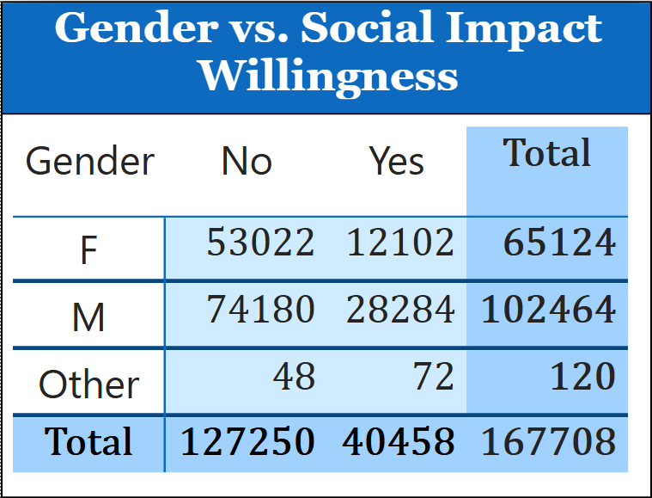
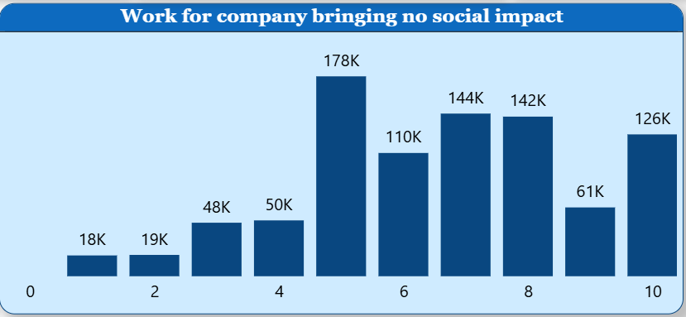

Slide 20
🌍 III. Mission Alignment & Social Impact Aspirations
3. Gender-Based Differences in Purpose Sensitivity
Female participants show higher resistance to working in mission-less companies (18.6% more likely to say "No" than male counterparts).
Reveals an opportunity for gender-sensitive talent strategies.
Purpose messaging has to be tailored by demographic segments for maximum impact.
4. Social Impact Visibility Drives Preference
Participants favored companies with high social impact visibility — notably in education, sustainability, and digital equity.
Suggests communication of impact (not just existence) is key.
Branding must emphasize outcomes of social good, not just policy presence.

Slide 21
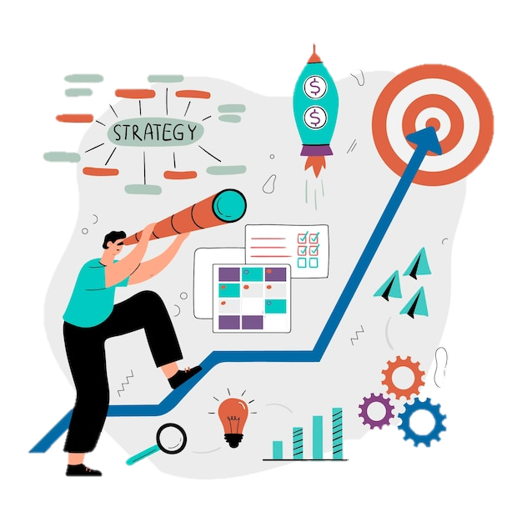
Strategic Recommendations
👔 For Employers (Culture, Structure & Work Design)
Design Hybrid Work as Default
Establish hybrid roles as a standard offering, not an exception.
Invest in tools and processes that enable seamless collaboration, both in-office and remote.
Build a Learning-Enabled Ecosystem
Integrate expert-led workshops, peer-learning sessions, and project-based learning into work routines.
Encourage L&D sponsorships, especially for international education, to retain high-potential talent.
Align Work Culture with Purpose & Impact
Clearly define and communicate your mission and societal contributions.
Make social impact part of day-to-day operations, not just CSR reports.
Develop Small-Team Structures
Organize departments into agile teams of 5–10, promoting ownership, creativity, and accountability.
Flatten hierarchy to enable faster decision-making and a sense of belonging.
Incentivize Loyalty through Value, Not Tenure
Offer fast-track growth paths and milestone-based rewards to encourage longer retention.
Shift from loyalty-based appraisal to impact-based appraisal.

Slide 22
🧑‍💼 For HR Professionals (Talent Development & Retention)
Introduce Regular Wellness and Break Interventions
Structure quarterly breaks or company-wide wellness days.
Normalize decompression as a productivity tool, not indulgence.
Rethink Managerial Training
Equip managers with coaching, feedback, and emotional intelligence tools.
Promote leadership styles that balance expectation with enablement.
Create Mission-to-Role Mapping
Help employees see how their work contributes to the larger mission.
Embed social purpose into performance frameworks and OKRs.
Run Value Fit Assessments During Onboarding
Introduce exercises to assess if a candidate's personal values align with organizational values.
Use it to tailor mentoring, team placement, and growth planning.
Implement Gender-Sensitive Employer Branding
Craft narratives that resonate with women’s higher mission-consciousness.
Position your firm as a purpose-driven, inclusive space with real impact.

Slide 23
🧲 For Recruiters (Talent Attraction & Messaging)
Highlight Purpose Before Perks
Position job postings to lead with company mission and impact, not just CTC and benefits.
Use storytelling formats to show how employees drive change.
Target Family Decision-Makers (for early-career roles)
Offer parent-oriented career webinars, alumni panels, and “career stability” brochures.
Recognize the parental influence in career decisions, especially in Asian markets.
Be Transparent About Growth & Rewards
Mention specific growth timelines, promotion cycles, learning budgets, and salary progression.
This builds trust and clarity, which Gen-Z craves in uncertain environments.
Promote Your Managerial Culture
Describe the type of managers and leadership philosophy in your organization.
Highlight stories of supportive leadership, mentorship, and goal alignment.
Differentiate Your EVP With Learning & Mobility
Use “Learn fast. Grow faster.”-style messaging to attract growth-hungry talent.
Spotlight internal mobility, cross-functional exposure, and sponsored education.

Slide 24
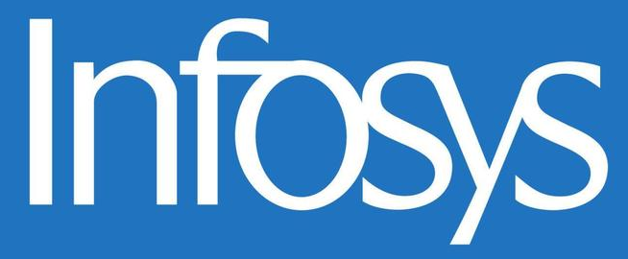
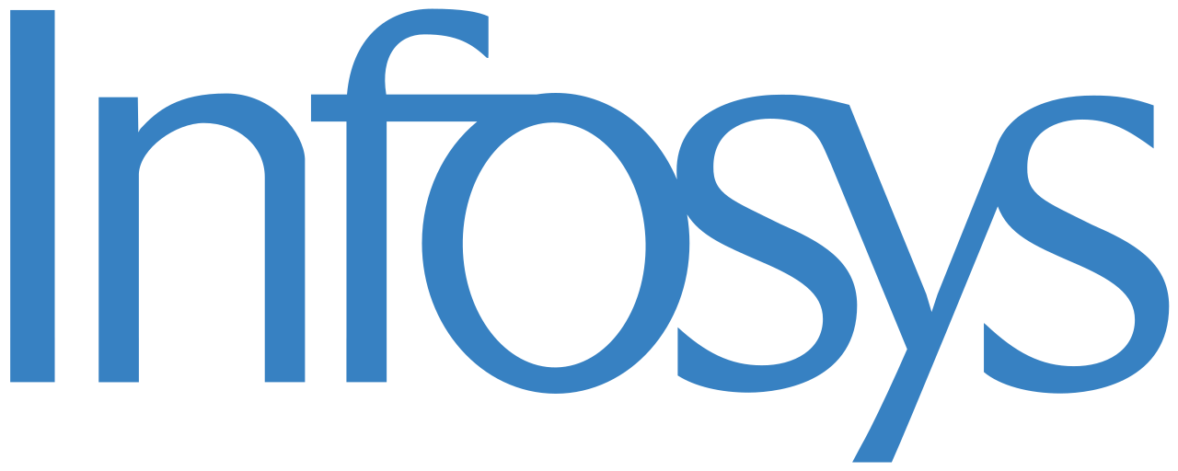
Applying Gen-Z Workforce Insights to Infosys
📌 Company Snapshot
Founded: 1981 | Headquarters: Bengaluru, India
Global Presence: 56+ countries
Employees: 330,000+
Core Services: IT consulting, digital transformation, cloud, AI, and outsourcing solutions
Positioning: Trusted innovation partner for global enterprises
👥 Talent Profile
60%+ workforce under age 30
Heavy campus hiring from top engineering and business colleges
Known for structured training programs (Infosys Global Education Center – Mysuru)
🔍 Current Employer Branding
Emphasizes learning, ethical leadership, and digital innovation
Recognized for diversity, inclusion, and sustainability practices

Slide 25
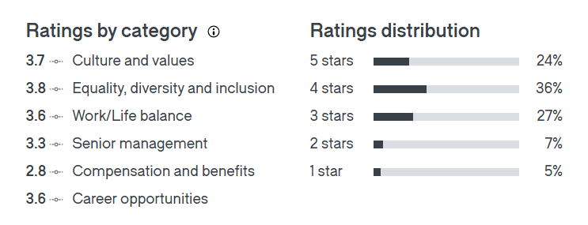
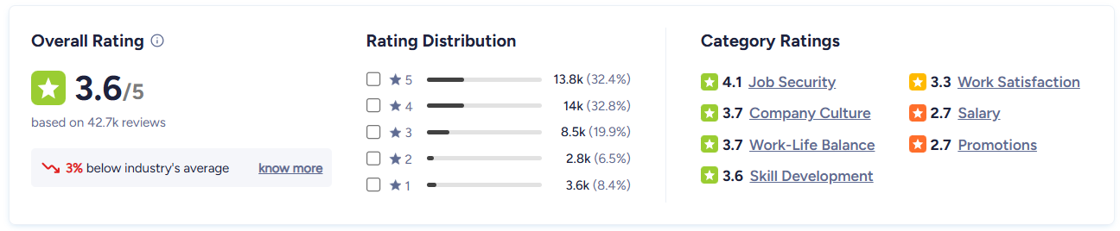
Ratings for Infosys
Glassdoor:
Ambitionbox:

Slide 26
Insights
Infosys offers strong job security and a stable work culture, which aligns well with Gen-Z’s need for reliability.
Work-life balance is average, but can be improved to match Gen-Z’s preference for regular mental health breaks.
Compensation, promotions, and salary growth are major dissatisfaction areas, conflicting with Gen-Z’s high financial aspirations.
Company culture and inclusivity are positively viewed, supporting Gen-Z’s values-driven career choices.
Leadership and senior management ratings are moderate, indicating a need for better communication, empathy, and growth opportunities.

Slide 27
Recommendations for Infosys
Revamp Compensation Strategy
Benchmark salaries competitively, especially for early career stages.
Introduce performance-based increments aligned with Gen-Z’s expectations (₹50k+ within 3 years).
Enhance Promotion Pathways
Implement transparent, skill-based promotion tracks to address dissatisfaction with career progression.
Create "fast-track" leadership programs for high-potential Gen-Z employees.
Foster Managerial Sensitivity
Strengthen training for managers to reduce perceived abuse or rigidity – 64K+ said “No” to abusive managers.
Encourage open feedback culture and leadership empathy.
Flexible Work Culture
Emphasize hybrid/flexible work options (preferred by over 60K Gen-Z respondents).
Reinforce the importance of mental health breaks – over 65K prefer a break every 2–3 months.
Socially Conscious Employer Branding
Promote Infosys as a mission-led, inclusive workplace – since many Gen-Z avoid “missionless” or “misaligned” companies.
Amplify stories on sustainability, innovation, and impact-driven projects.

Slide 28
Conclusion
Gen-Z is redefining the employer-employee relationship by seeking purpose, flexibility, and accelerated growth — not just jobs. Their expectations reflect a generation that values meaningful work, continuous learning, and emotional alignment with the organizations they join.
To remain attractive and competitive in this evolving landscape, employers must move beyond transactional offerings. This generation demands mission-led cultures, agile work environments, and personalized development paths. Organizations that respond with authenticity, adaptability, and vision will not only attract top Gen-Z talent but also build a future-ready workforce rooted in loyalty, innovation, and shared purpose.

Slide 29
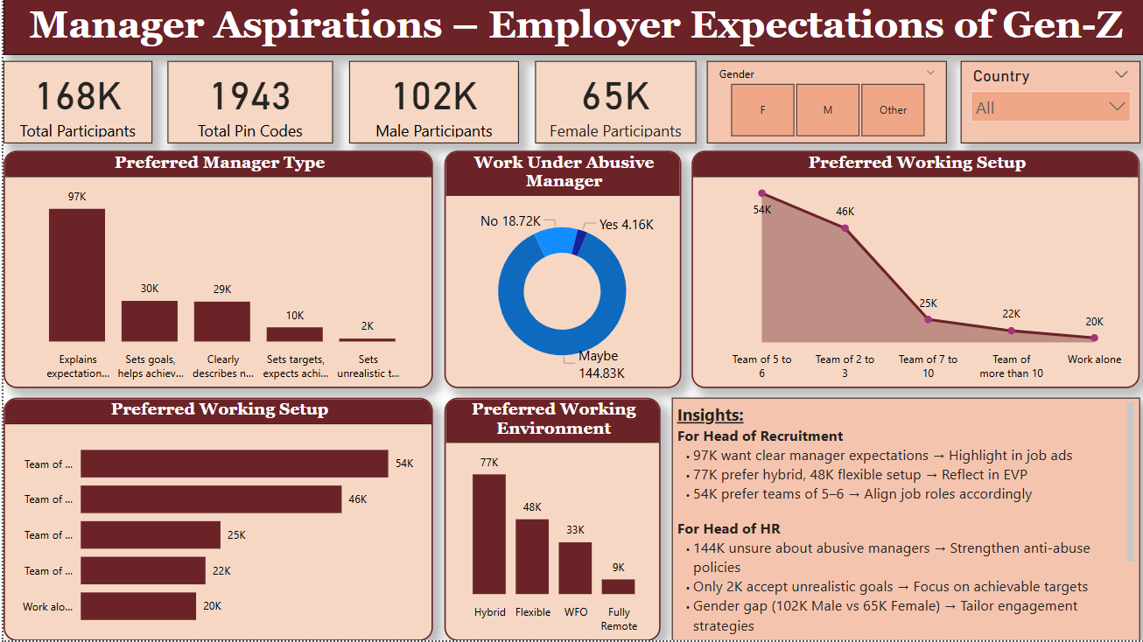
Appendix
PowerBI Dashboard 1

Slide 30
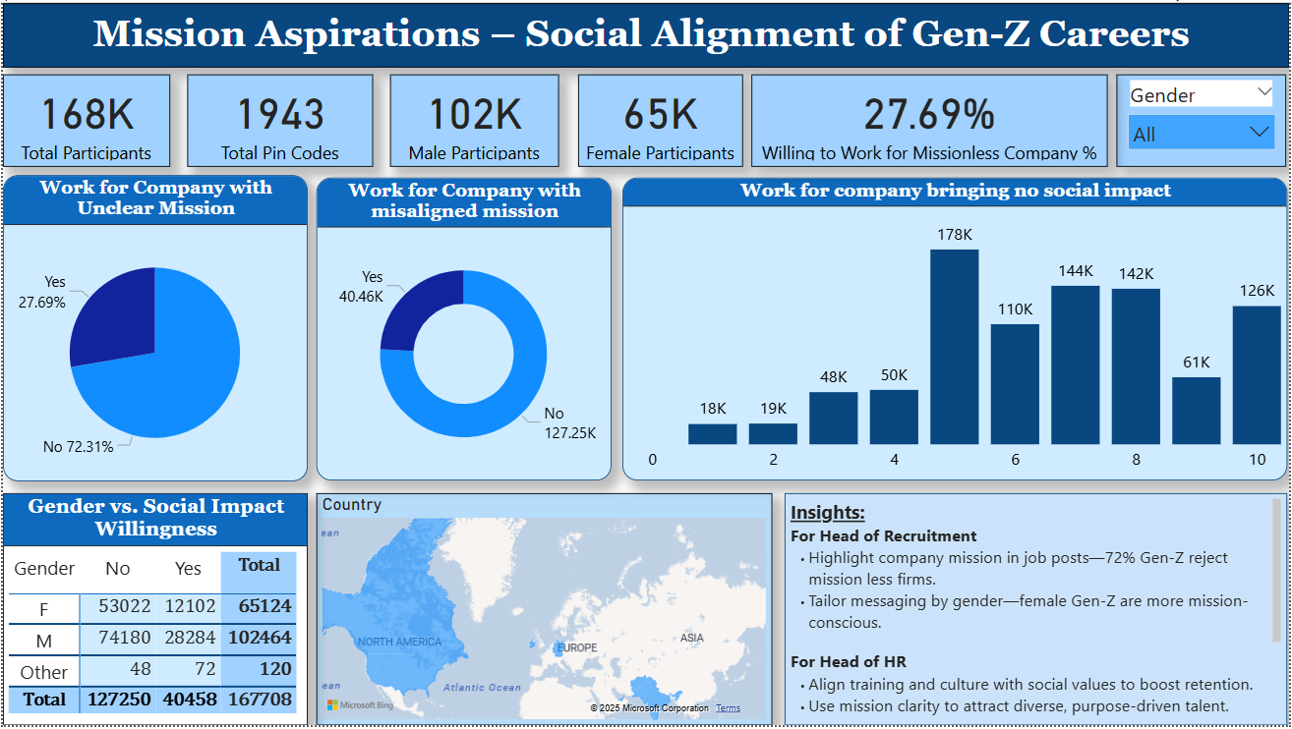
PowerBI Dashboard 2

Slide 31
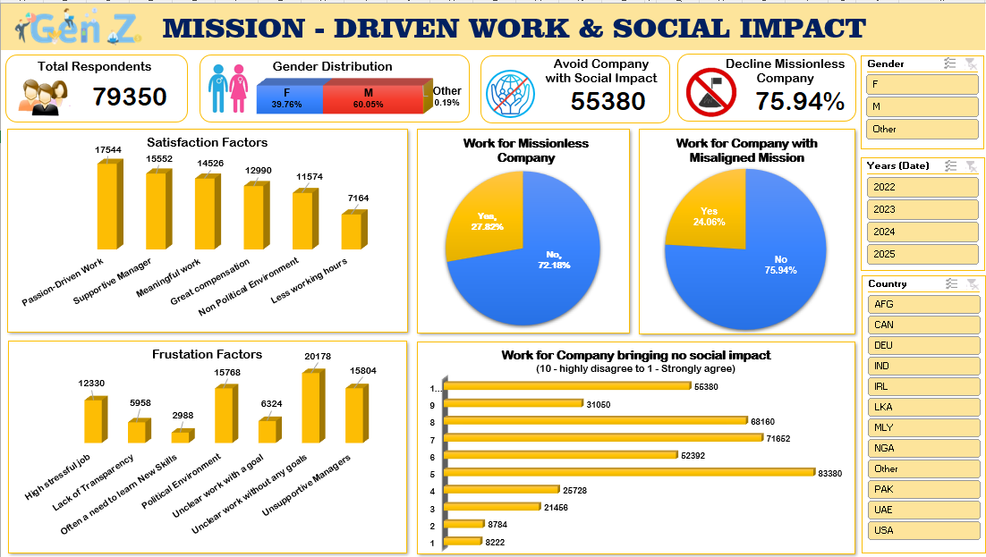
Excel Dashboard 1

Slide 32
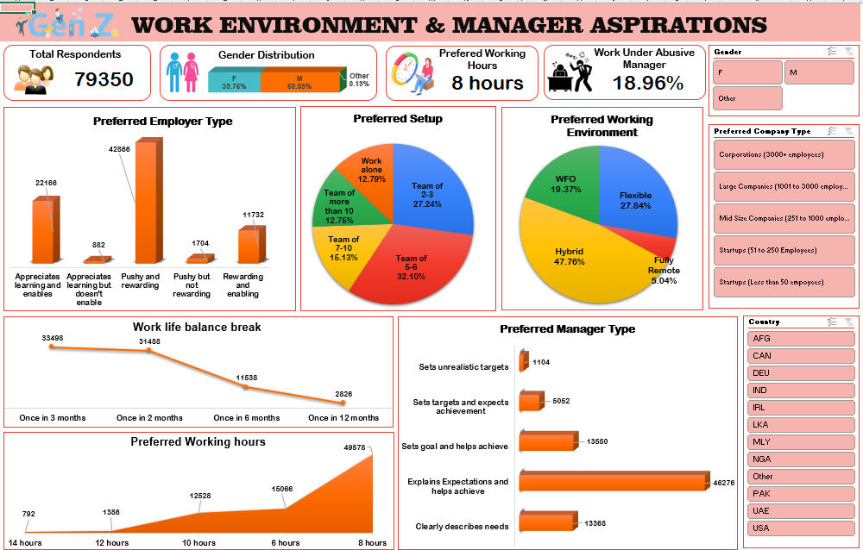
Excel Dashboard 2

Slide 33
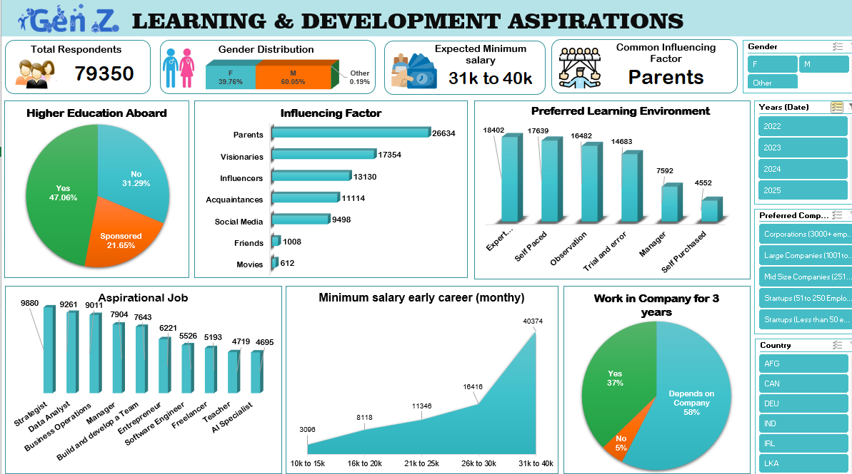
Excel Dashboard 3

Slide 34
THANK YOU !
Grateful to KultureHire for the valuable Learnternship opportunity and hands-on experience with real Gen-Z insights.

